Slide 1

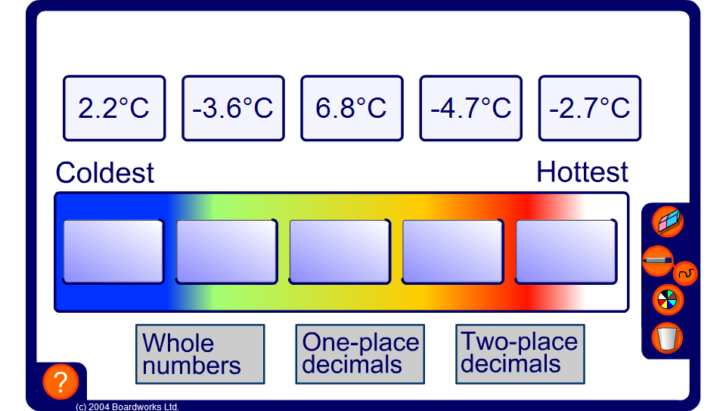


Ordering temperatures
Notes:
Ask pulpits to put the temperatures in order from coldest to hottest.
Extend the activity by including decimals.
Link:
N1 Place value, ordering and rounding – ordering decimals

